Slide 1
A new Question Answernig Approach with Conceptual Graphs
Doyeon Lim
2018.03.08

Slide 2
Contents
Question Answering
Key Elements in CGQA
Converting Text to CG
CGQA Process
Experiment – Task and Dataset – Result
Discussion
Conclusion

Slide 3
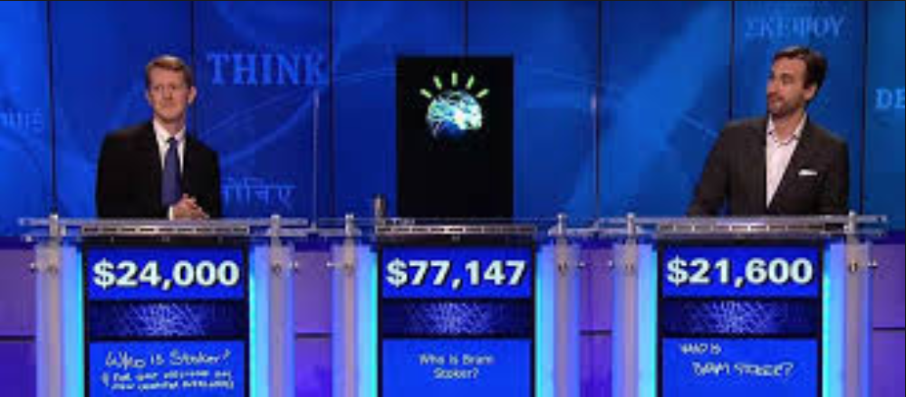
Question Answering
Increasing availability of large-scale structred knowledge bases (KB) and natural language processing (NLP) aided by advanced information retrieval (IR) → Question Answering (QA) systems have entered into a commercialization era
Notes:
IBM Watson

Slide 4
Question Answering
KBQA
knowledge base is composed of set of triples (universal fact) e.g) (Burak Obama, spouse of, Michelle obama)
context information (time, location, related objects, topics) from the original information source are rarely linked in KB
Yago, DBpedia, Freebase
IRQA
statistical approaches and ad-hoc processing
retrieve documents that are similar to the question and then extract and rank answer candidates
hard to collect dispersed pieces of evidence among documents
Notes:
To remind about graph or network representation, this is an application of graph representation
Converting sparse and high-dimension information to dense and low-dimension form, we can use that information more easily and efficiently.
Also computational cost will be much cheaper

Slide 5
Question Answering
Limitation of KBQA
lack of an ability to discriminate against different contexts
difficulty in approximate reasoning
Limitation of IRQA
Structural, semantic aspects in the question and the text cannot be enforced
Relies on local search
Notes:
Since KBQA usually makes inference by connecting triples, it is not straightforward to mimic probabilistic inference

Slide 6
Question Answering
CGQA
Context-driven knowledge representation & Informal inference
Generating conceptual graphs from text
Efficient graph matching algorithms as an inference mechanism
Notes:
To remind about graph or network representation, this is an application of graph representation
Converting sparse and high-dimension information to dense and low-dimension form, we can use that information more easily and efficiently.
Also computational cost will be much cheaper

Slide 7
Key Elements in CGQA
Definition 1 (Concept)
A concept 𝑐 ∈ 𝐶 is an abstract notion (e.g. ‘economy’) or an entity of a real-world (e.g. ‘tiger’ and ‘Obama’)
Definition 2 (Relation)
A relation 𝑟 ∈ 𝑅 is a property of a concept or an action or a state between two concepts (e.g. ‘PARENT_OF’ and ‘LIVES_IN’)
Notes:
Noun or noun complex / Each concept encoded with a unique identifier in the QA system
A relation is usually expressed in text with an adjective phrase, verb phrase, or prepositional phrase / revealed by a sequence of words between and around two concepts in a text.

Slide 8
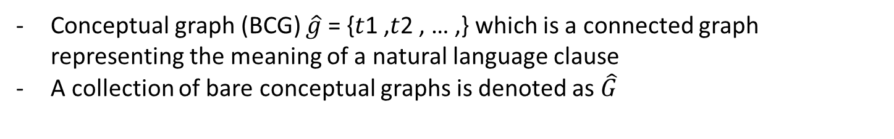
Key Elements in CGQA
Definition 3 (Knowledge Triple)
A knowledge triple 𝑡 =< 𝑐𝑖 , 𝑟, 𝑐𝑗 > , where 𝑐𝑖 , 𝑐𝑗 ∈ 𝐶 and 𝑐𝑖 ≠ 𝑐𝑗
Basic unit of knowledge that constitutes a conceptual graph
“A robot appears in a play” → <robot, appear, play>
Conceptual graph can be constructed by merging the common concept nodes of triples
Definition 4 (Bare Conceptual Graph)
Conceptual graph (BCG) $\hat{g}$ = {𝑡1 ,𝑡2 , … ,} which is a connected graph representing the meaning of a natural language clause
A collection of bare conceptual graphs is denoted as $\hat{\text{G}}$
Notes:
The question includes two contexts: ‘our galaxy’ and ‘Hubble’s categorization’. Without referring to the specific contexts, the system may find a wrong answer like ‘spiral galaxy’ (from the ‘Andromeda galaxy’ context) or ‘black hole based galaxy’ (from other categorization context).

Slide 9
Key Elements in CGQA
Role of Context
Question: What is the type of our galaxy (Milky Way) based on Hubble’s categorization? Answer: Barred spiral galaxy
Merge two concept without considering their context lead mismatch of concept.
e.g) <robot, appear, play> <Hubo, is_a, robot>
Notes:
The question includes two contexts: ‘our galaxy’ and ‘Hubble’s categorization’. Without referring to the specific contexts, the system may find a wrong answer like ‘spiral galaxy’ (from the ‘Andromeda galaxy’ context) or ‘black hole based galaxy’ (from other categorization context).

Slide 10
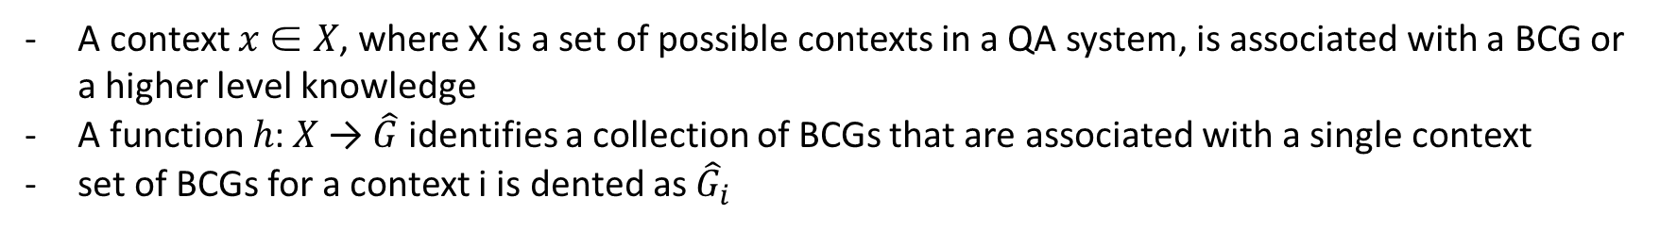
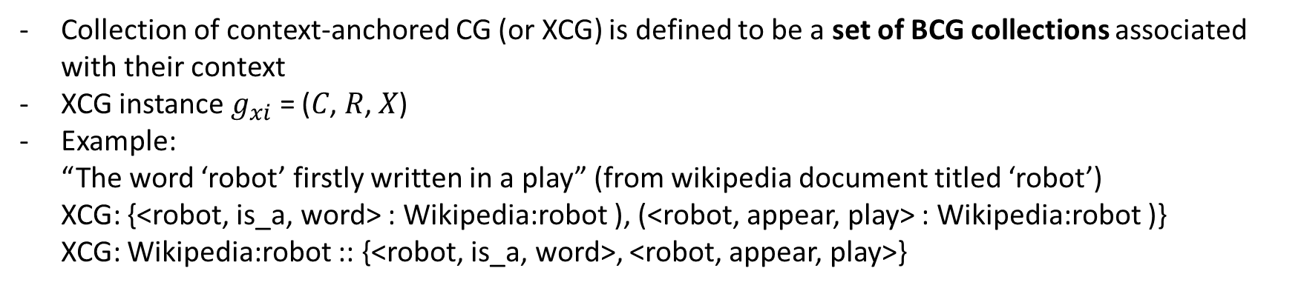
Key Elements in CGQA
Definition 5 (Context)
A context 𝑥 ∈ 𝑋, where X is a set of possible contexts in a QA system, is associated with a BCG or a higher level knowledge
A function ℎ: 𝑋 → $\hat{\text{G}}$ identifies a collection of BCGs that are associated with a single context
set of BCGs for a context i is dented as ${\hat{\text{G}}}_{i}$
Definition 6 (Context-Anchored Conceptual Graph)
Collection of context-anchored CG (or XCG) is defined to be a set of BCG collections associated with their context
XCG instance $g_{xi}$ = (𝐶, 𝑅, 𝑋)
Example: “The word ‘robot’ firstly written in a play” (from wikipedia document titled ‘robot’) XCG: {<robot, is_a, word> : Wikipedia:robot ), (<robot, appear, play> : Wikipedia:robot )} XCG: Wikipedia:robot :: {<robot, is_a, word>, <robot, appear, play>}
Notes:
A QA system must have its own definition of possible contexts or X
we simply define X to be different Wikipedia articles
concepts with the same surface form appearing in a single Wikipedia article refer to the same entity or abstract notion because they are in the same context.
→ there can be exception, eventhough it is in same sentence in same article with same form, it can be different ** any idea? Example?

Slide 11
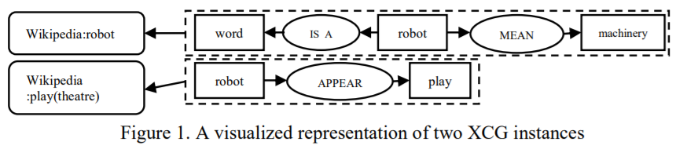
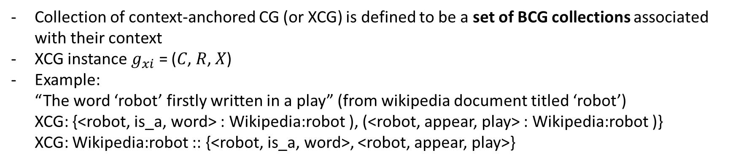
Key Elements in CGQA
Definition 6 (Context-Anchored Conceptual Graph)
Collection of context-anchored CG (or XCG) is defined to be a set of BCG collections associated with their context
XCG instance $g_{xi}$ = (𝐶, 𝑅, 𝑋)
Example: “The word ‘robot’ firstly written in a play” (from wikipedia document titled ‘robot’) XCG: {<robot, is_a, word> : Wikipedia:robot ), (<robot, appear, play> : Wikipedia:robot )} XCG: Wikipedia:robot :: {<robot, is_a, word>, <robot, appear, play>}
Notes:
A QA system must have its own definition of possible contexts or X
we simply define X to be different Wikipedia articles
concepts with the same surface form appearing in a single Wikipedia article refer to the same entity or abstract notion because they are in the same context.
→ there can be exception, eventhough it is in same sentence in same article with same form, it can be different ** any idea? Example?
Type of informal inference is conducted at the time of CG construction only within the same context → way of define context determine the flexibility

Slide 12
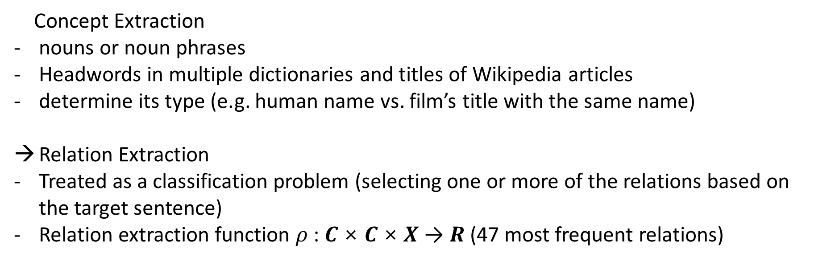
Converting Text to CG
Concept Extraction
nouns or noun phrases
Headwords in multiple dictionaries and titles of Wikipedia articles
determine its type (e.g. human name vs. film’s title with the same name)
Relation Extraction
Treated as a classification problem (selecting one or more of the relations based on the target sentence)
Relation extraction function $ρ$ : 𝑪 × 𝑪 × 𝑿 → 𝑹 (47 most frequent relations)
Notes:
The type classifier is trained by word2vec

Slide 13

CGQA Process
𝑚: ${\text{G}}_{Q}$ → $G_{KB}$
maps a question CG to a KBCG → relevant subgraph (concept node) is returned
Definition 7 (CGQA System Kernel)
Receives a question graph ${\text{g}}_{Q}$ → searches a KB
query CG construction → context search → graph matching → answer ranking
Notes:
context search process alleviates the problem by limiting the search only to those graphs in a specific context
the result of the context search process is a set of Wikipedia articles
Graph matching generates candidate sub-graphs
answer ranking process aggregates the graph matching result and rank answer candidates

Slide 14
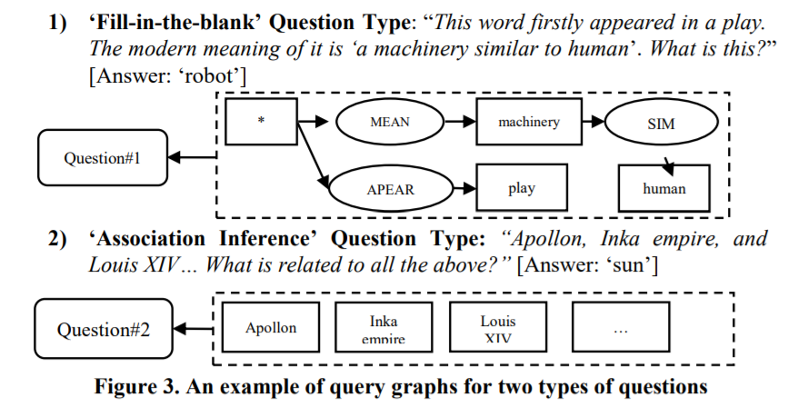
CGQA Process
Query Graph Construction
‘fill-in-the-blank’ & ‘association inference’
Notes:
During the graph matching process, wildcard concepts should be matched with any concepts that are returned as potent answer candidates. The missing concept node is marked with a wildcard, and the QA process needs to find a concept to replace it.
The latter type asks for a concept that should be inferred by a list of explanations in the question
**firstly 안중요한가?

Slide 15
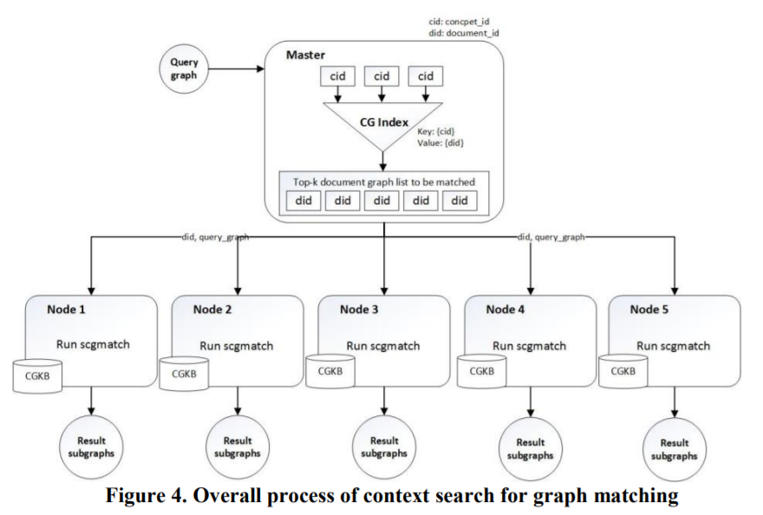

CGQA Process
Query Graph Construction
deg(c, d) is the number of relations directly linked to the concept c in the context-anchored graph d
Score: context-anchored graph <-> query CG (qCG) sum of the TF-IDF scores of all concepts in the query graph
Notes:
During the graph matching process, wildcard concepts should be matched with any concepts that are returned as potent answer candidates. The missing concept node is marked with a wildcard, and the QA process needs to find a concept to replace it.
The latter type asks for a concept that should be inferred by a list of explanations in the question
**firstly 안중요한가?

Slide 16

CGQA Process
Graph Matching
to find the centroid of the best matching part between a query graph and a document graph
Definition 8 (graph matching algorithm) – fill-in-the-blank
Input: query graph, document graph Output: top-k sub-graphs from each document graph
To rank sub-graph score is computed which indicates a structural score based on edges
Scoring wild card node
𝑺(𝑤): source non-wild concepts
𝑻(𝑤) : destination non-wild concepts
m(s): Matched concept node of s (qCG) in document graph
Notes:
During the graph matching process, wildcard concepts should be matched with any concepts that are returned as potent answer candidates. The missing concept node is marked with a wildcard, and the QA process needs to find a concept to replace it.
The latter type asks for a concept that should be inferred by a list of explanations in the question
**firstly 안중요한가?

Slide 17

CGQA Process
Graph Matching
to find the centroid of the best matching part between a query graph and a document graph
Definition 8 (graph matching algorithm) – Association Inference
Input: query graph, document graph Output: top-k sub-graphs from each document graph
To rank sub-graph score is computed which indicates a structural score based on edges
Notes:
During the graph matching process, wildcard concepts should be matched with any concepts that are returned as potent answer candidates. The missing concept node is marked with a wildcard, and the QA process needs to find a concept to replace it.
The latter type asks for a concept that should be inferred by a list of explanations in the question
**firstly 안중요한가?

Slide 18

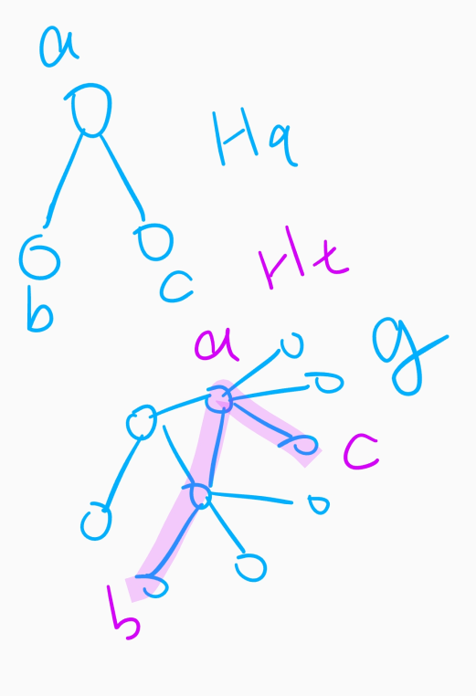
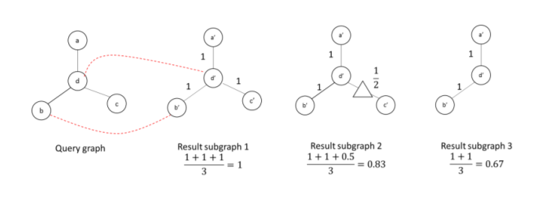
CGQA Process
Definition 8 (graph matching algorithm)
Set of paths
# of edges
Notes:
During the graph matching process, wildcard concepts should be matched with any concepts that are returned as potent answer candidates. The missing concept node is marked with a wildcard, and the QA process needs to find a concept to replace it.
The latter type asks for a concept that should be inferred by a list of explanations in the question
**firstly 안중요한가?

Slide 19
Experiment – Task and Dataset
Jang-hak Quiz: contestants which high school students participlate in live show to get scholarship
Notes:
During the graph matching process, wildcard concepts should be matched with any concepts that are returned as potent answer candidates. The missing concept node is marked with a wildcard, and the QA process needs to find a concept to replace it.
The latter type asks for a concept that should be inferred by a list of explanations in the question
**firstly 안중요한가?

Slide 20
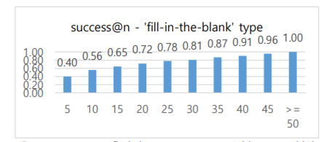
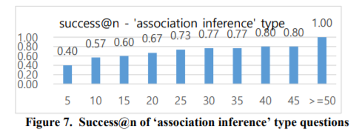
Experiment – Result
Notes:
During the graph matching process, wildcard concepts should be matched with any concepts that are returned as potent answer candidates. The missing concept node is marked with a wildcard, and the QA process needs to find a concept to replace it.
The latter type asks for a concept that should be inferred by a list of explanations in the question
**firstly 안중요한가?

Slide 21
Discussion
Key contribute: explicit use of context for QA → reducing the search space & enhancing the effectiveness
sub-graph scores → topologically similar to the query graph without considering the importance of each concept & relation in the query graph
++ - candidate training with multiple features (Aqqu system) - not using exact node but similar nodes
-
Notes:
During the graph matching process, wildcard concepts should be matched with any concepts that are returned as potent answer candidates. The missing concept node is marked with a wildcard, and the QA process needs to find a concept to replace it.
The latter type asks for a concept that should be inferred by a list of explanations in the question
**firstly 안중요한가?

Slide 22
Conclusion
Enables informal inference and context-driven knowledge representation
helps answering ‘hard’ questions that require processing of contexts
Future work: - Define a variety of context types → better the graph matching - Approximate matching in computing concept-concept or relation-relation similarity
Notes:
relax the rigidity of graph matching for higher recall

